Slide 1
Chapter 2
Application Layer
2-<number>

Slide 2
Chapter 2: Application layer
DNS
2-<number>

Slide 3
DNS: Domain Name System
People: many identifiers:
  SSN, name, passport #
Internet hosts, routers:
  “name”, e.g., ww.yahoo.com - used by humans
  IP address (32 bit) - used for addressing datagrams
Q: map between IP addresses and name ?
Domain Name System:
application-layer protocol host, routers, name servers to communicate to resolve names (address/name translation)
  note: core Internet function, implemented as application-layer protocol
  complexity at network’s “edge”
distributed database implemented in hierarchy of many name servers
2-<number>

Slide 4
DNS
DNS services
Hostname to IP address translation
Host aliasing
  Canonical and alias names
  Mail server aliasing
Load distribution
  Replicated Web servers: set of IP addresses for one canonical name
Why not centralize DNS?
single point of failure
traffic volume
distant centralized database
maintenance
doesn’t scale!
2-<number>

Slide 5
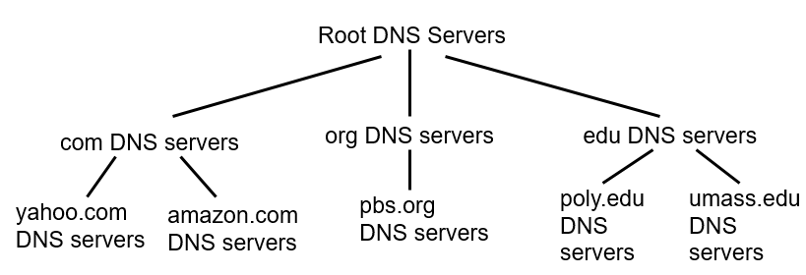

Distributed, Hierarchical Database
GTLD: https://www.iana.org/domains/root/db/apple.html
a Verisign, Dulles, VA
c Cogent, Herndon, VA (also Los Angeles)
d U Maryland College Park, MD
g US DoD Vienna, VA
h ARL Aberdeen, MD
j Verisign, ( 11 locations)
Who operates the root servers?
The root servers are operated by 12 different organizations:
A VeriSign Global Registry Services
B University of Southern California
C Cogent Communications
D University of Maryland
E NASA Ames Research Center
F Internet Systems Consortium, Inc.
G US DoD Network Information Center
H US Army Research Lab
I Netnod
J VeriSign Global Registry Services
K RIPE NCC
L ICANN
M WIDE Project
- 13 root NS
- 750 root NS
instances around the world
k RIPE London (also Amsterdam, Frankfurt)
i Autonomica, Stockholm (plus 3 other locations)
m WIDE Tokyo
e NASA Mt View, CA
f Internet Software C. Palo Alto, CA (and 17 other locations)
b USC-ISI Marina del Rey, CA
l ICANN Los Angeles, CA
2-<number>

Slide 6
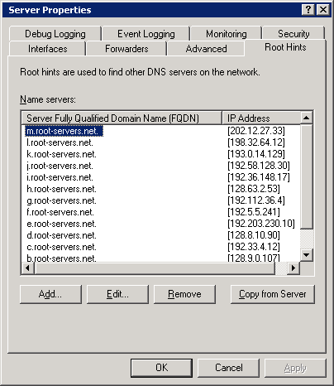
Distributed, Hierarchical Database
GTLD: https://www.iana.org/domains/root/db/apple.html
a Verisign, Dulles, VA
c Cogent, Herndon, VA (also Los Angeles)
d U Maryland College Park, MD
g US DoD Vienna, VA
h ARL Aberdeen, MD
j Verisign, ( 11 locations)
Who operates the root servers?
The root servers are operated by 12 different organizations:
A VeriSign Global Registry Services
B University of Southern California, Information Sciences Institute
C Cogent Communications
D University of Maryland
E NASA Ames Research Center
F Internet Systems Consortium, Inc.
G US DoD Network Information Center
H US Army Research Lab
I Netnod
J VeriSign Global Registry Services
K RIPE NCC
L ICANN
M WIDE Project
- 13 root NS
- 750 root NS
instances around the world
k RIPE London (also Amsterdam, Frankfurt)
i Autonomica, Stockholm (plus 3 other locations)
m WIDE Tokyo
e NASA Mt View, CA
f Internet Software C. Palo Alto, CA (and 17 other locations)
b USC-ISI Marina del Rey, CA
l ICANN Los Angeles, CA
2-<number>

Slide 7
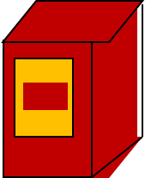

DNS Operation- (Iterative mode) Example
root DNS server
2
Host @ cis.poly.edu wants IP address for gaia.cs.umass.edu
iterated query:
contacted server replies with name of server to contact
“I don’t know this name, but ask this server”
3
4
EDU TLD
DNS server
authoritative DNS server
dns.poly.edu
5
authoritative DNS server
dns.umass.edu
1 www.gaia.cs.umass.edu
7
6
8
Requesting host
cis.poly.edu
Target host
www.gaia.cs.umass.edu

Slide 8
Recursive queries
root DNS server
recursive query:
puts burden of name resolution on contacted name server
heavy load?
2
3
7
6
TLD DNS server
authoritative DNS server
dns.poly.edu
5
4
1
8
authoritative DNS server
dns.cs.umass.edu
requesting host
cis.poly.edu
gaia.cs.umass.edu
2-<number>

Slide 9
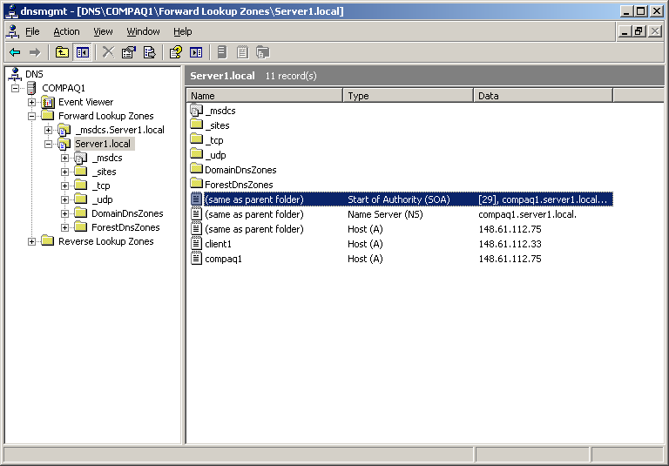
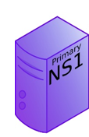
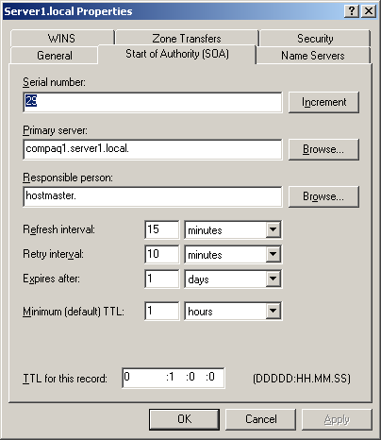
Authoritative DNS Implementation
2-<number>

Slide 10
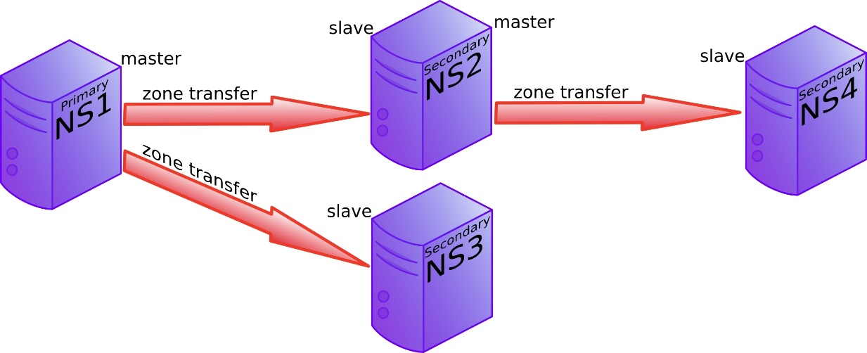
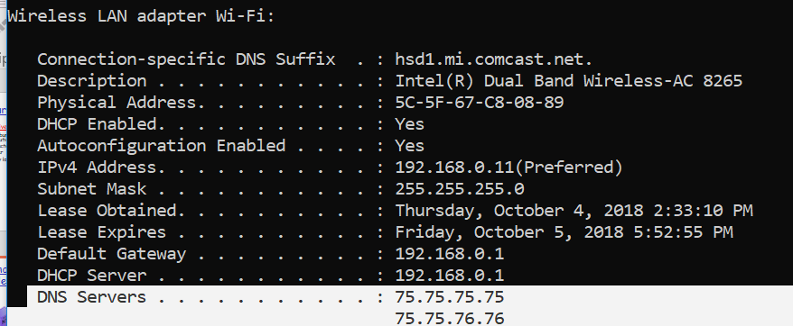
Authoritative DNS Implementation
2-<number>

Slide 11
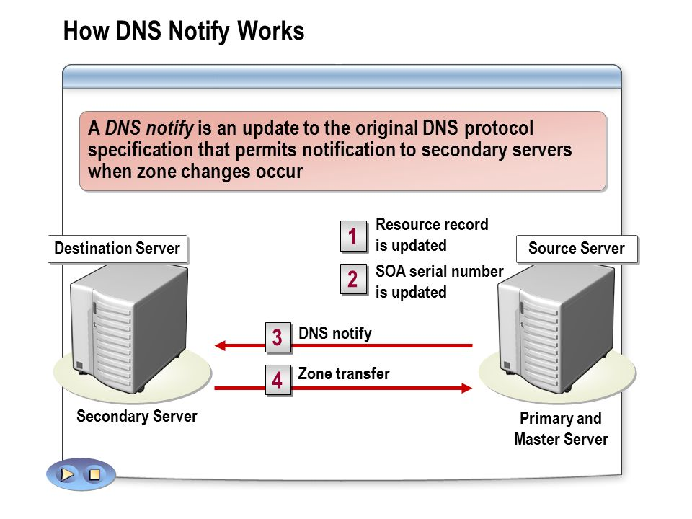
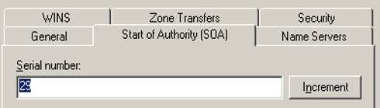
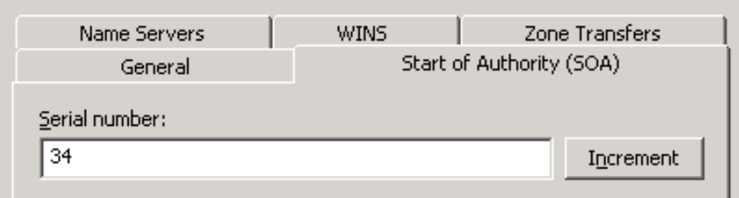
DNS Zone Replication
2-<number>

Slide 12
DNS: caching and updating records
once (any) name server learns mapping, it caches mapping
  cache entries timeout (disappear) after some time
  TLD servers typically cached in local name servers
    Thus root name servers not often visited
update/notify mechanisms under design by IETF
  RFC 2136
  http://www.ietf.org/html.charters/dnsind-charter.html
2-<number>

Slide 13

DNS protocol, messages
DNS protocol : query and reply messages, both with same message format
msg header
identification: 16 bit # for query, reply
Query and response use same #
flags:
  query or reply
  recursion desired
  recursion available
  reply is authoritative
2-<number>

Slide 14
Case Study
Example: just created startup “Network Utopia”
Register name networkuptopia.com at a registrar (e.g., Network Solutions)
  Need to provide registrar with names and IP addresses of your authoritative name server (primary and secondary)
  Registrar inserts two RRs into the com TLD server:
  (networkutopia.com, dns1.networkutopia.com, NS)
  (dns1.networkutopia.com, 212.212.212.1, A)
Then, put in the authoritative server (dns1.networkutopia.com) a type A record for www.networkuptopia.com and Type MX record for networkutopia.com
  (www.networkutopia.com, 212.212.212.2, A)
  (networkutopia.com, 212.212.212.2, A)
  (networkutopia.com, mail01.networkutopia.com, MX)
  (mail01.networkutopia.com, 212.212.212.3, A)
2-<number>

Slide 15
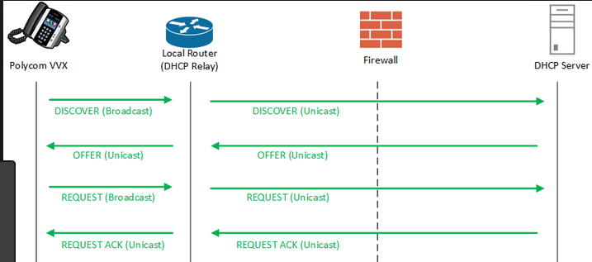
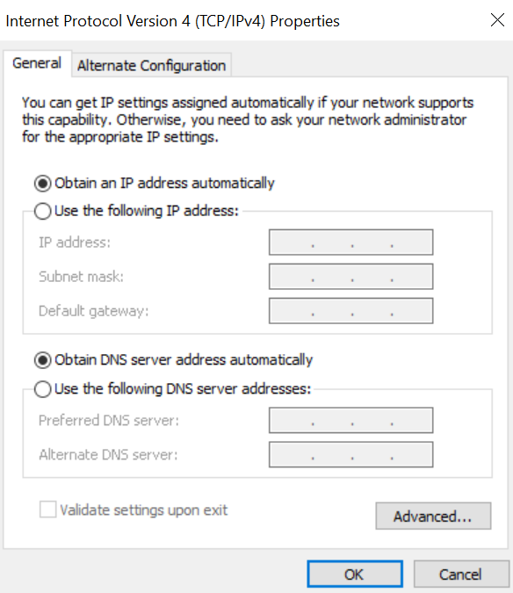
DNS Spoofing to steal victim’s data
How DHCP works?
2-<number>

Slide 16
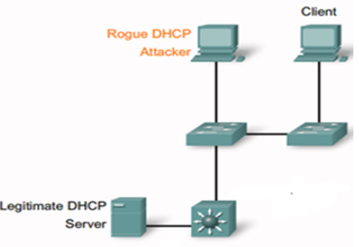
Attack in Switched Environment
DNS Spoofing to steal victim’s data
6-<number>

